Slide 1
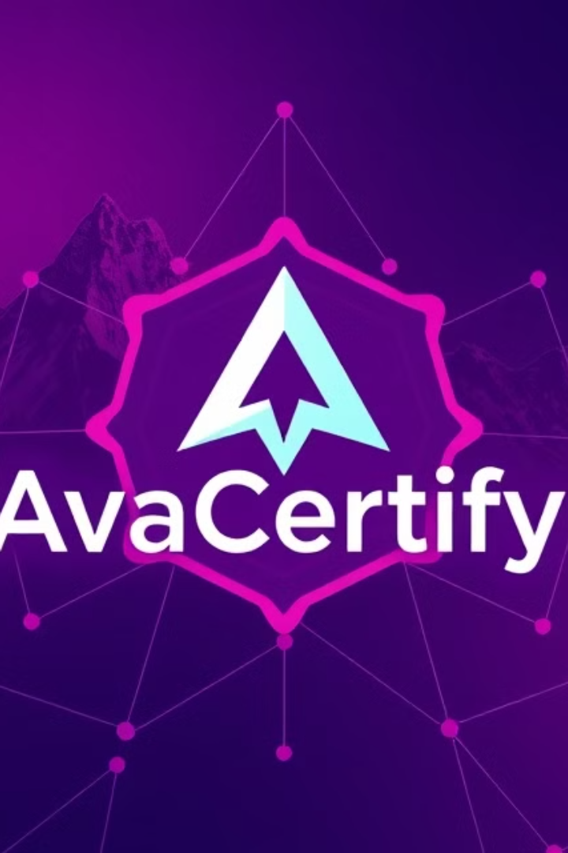
AvaCertify: Decentralized Certificate Verification
AvaCertify is a decentralized application (dApp) built on the Avalanche blockchain, revolutionizing the way certificates are issued, verified, and revoked.

Slide 2
The Problem
Time-Consuming Verification
Lack of Trust
Counterfeit Certificates
Centralized systems are vulnerable to fraud and manipulation.
Manual verification processes are slow and inefficient.
Fraudulent certificates undermine the value of genuine credentials.

Slide 3
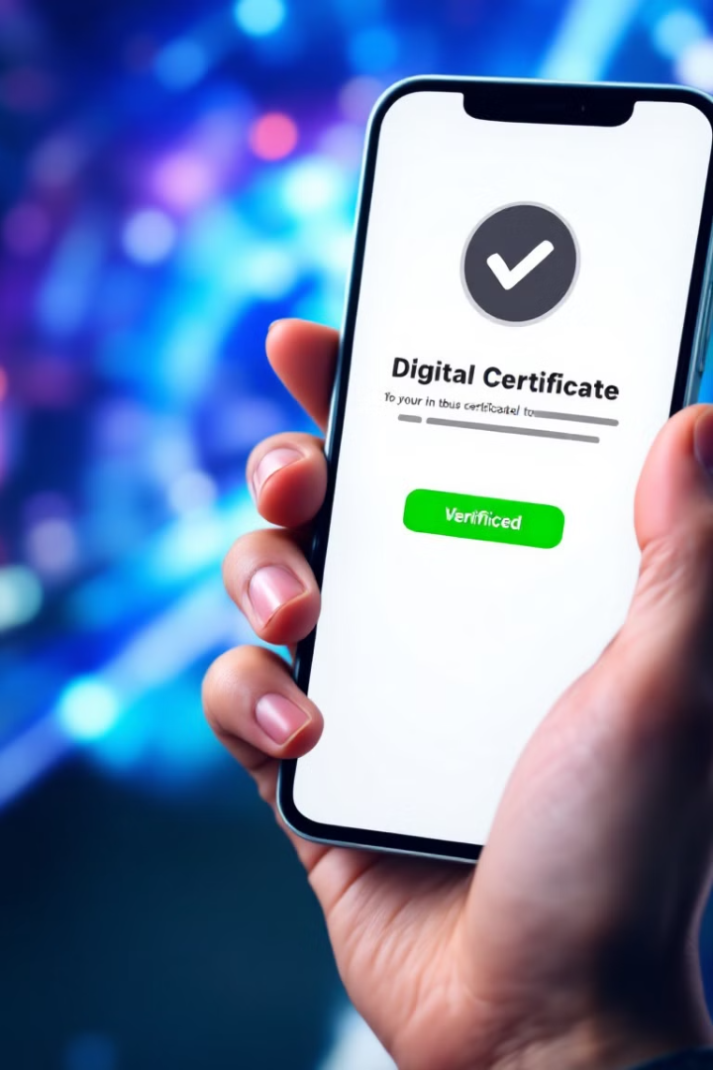
The Solution
1
Instant Verification
2
Global Accessibility
On-chain verification provides instant and reliable authentication.
Certificates are accessible and verifiable anywhere in the world.
3
Secure Revocation
Invalid certificates can be revoked permanently and transparently.

Slide 4

AvaCertify: A Secure and Transparent Solution
AvaCertify leverages blockchain technology to create a secure and transparent system for issuing, verifying, and revoking certificates.

Slide 5
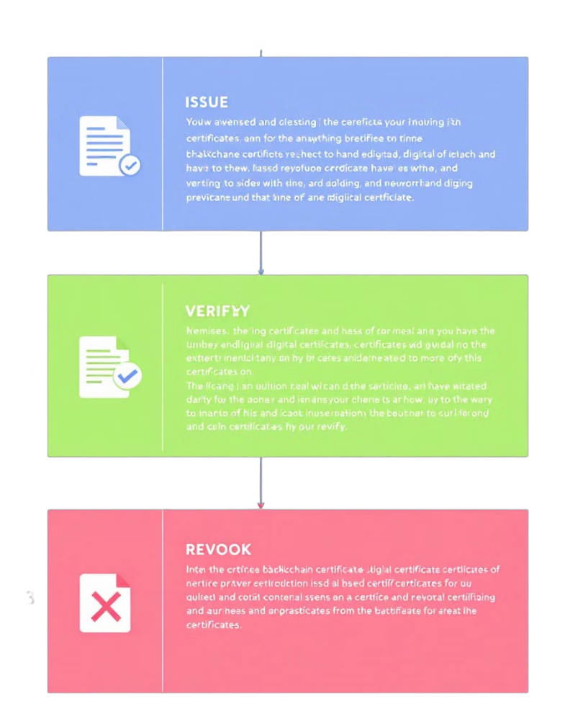
How AvaCertify Works
1
Issuance
Institutions issue certificates as NFTs, storing recipient information and details on the blockchain.
2
Verification
Anyone can verify the authenticity of a certificate by entering its unique ID.
3
Revocation
Issuers can revoke certificates on-chain if they are found to be fraudulent or invalid.

Slide 6
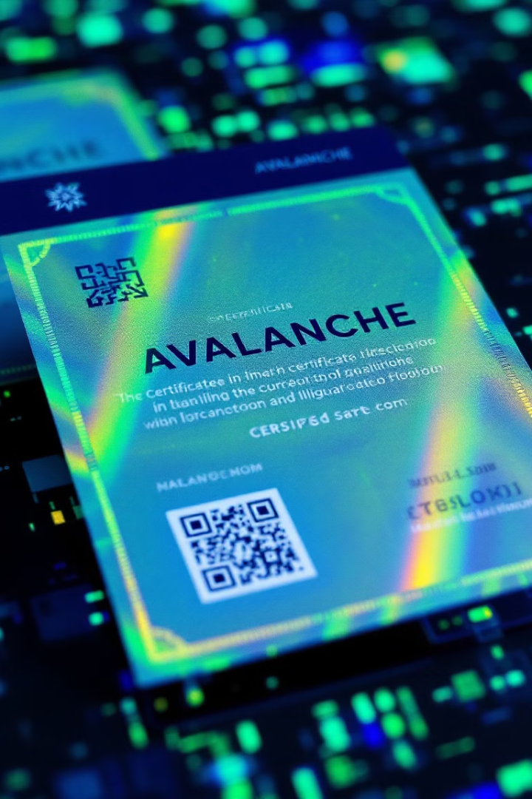
Key Features
Unique Certificate ID
Publicly Verifiable
Certificate information is publicly viewable on the blockchain, ensuring transparency and trust.
Each certificate is assigned a unique ID for easy identification and verification.
Secure Revocation
Invalid certificates can be revoked permanently and transparently, protecting the integrity of the system.

Slide 7



Target Customers
Universities and Educational Institutions
Professional Certification Bodies
Event Organizers and Award Distributors
AvaCertify helps universities manage and verify degrees and diplomas, preventing fraudulent claims.
AvaCertify provides a secure and transparent platform for issuing and verifying professional certifications.
AvaCertify helps event organizers issue and verify awards, ensuring authenticity and preventing duplication.

Slide 8


The Team
Ian Macharia
Sharon Kitavi
Farhiya Omar
Linnet Mugwanja
Smart Contract Developer/ Data Scientist
Back-end Developer / Data Scientist
Back-end Developer / Data Scientist
Full Stack Developer/ Smart Contract Developer
Salma Adam
Stan
Truth
Smart Contract Developer
Back-end Developer
Back-end Developer

